Slide 1
Mathematics (9-1) - iGCSE
2018-20
Year 09
Unit 19 – Answers

Slide 2
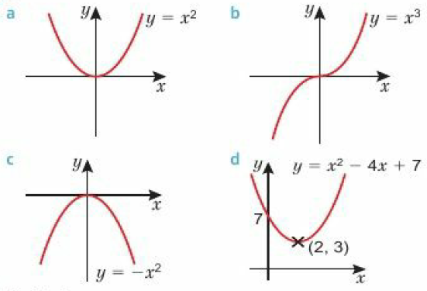
19 - Prior knowledge check
Page 706
a. 1.33m/s² b. 2m/s' c. 2200m or 2.2km
C

Slide 3
19 - Prior knowledge check
Page 706
Ab, Bc, Ca
a. y = (cosx) - 1 b. y = 2cosx
24 minutes
a. $\frac{1}{3}$ b. 2 c. $\frac{1}{x}$
a. $\frac{1}{4}$ b. $\frac{1}{2}$ c. 1 d. 9 e. $\frac{1}{3}$

Slide 4
19 - Prior knowledge check
Page 706
a. c and d b. d = 7c
a. 10 b. ±2 c. 2(x² + 6x - 5)
a. 4 and 0.25, 8 and 0.125, 5 and 0.2, 10 and 0.1, 2.5 and 4.1.6 and 0.625 b. Students' own answers

Slide 5
19.1 – Direct Proportion
Page 706
a. Yes; C = 0.84q b. No c. No d. No

Slide 6
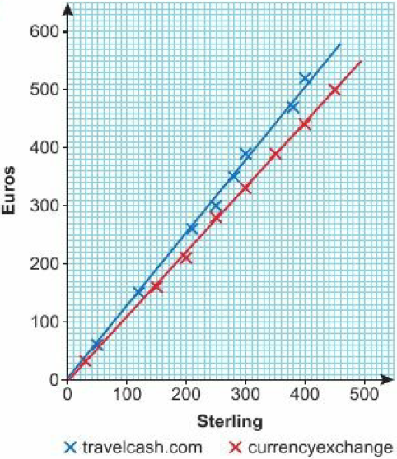
19.1 – Direct Proportion
Page 706
a. b.
i. E = 1.25S (where gradient is taken from students’ graphs) ii. E = 1.1S (where gradient is taken from students' graphs)
travelcash.com

Slide 7
19.1 – Direct Proportion
Page 707
a. y = 5x b. y = 50 c. x = 13
a. y = 6.5x b. y = 91 c. x = 22
a. x = 5 b. x = 10.1 (1 d.p.) c. x = 8.125
a. y = $\frac{x}{60}$ b. y = 9

Slide 8
19.2 – More Direct Proportion
Page 707
k = 2.5
a. F = 8a b. 160 c. 14
a. The ratio of P:L simplifies to 12:5 for all pairs of values. b. k = 2.4 c. P = 2.4L d. i. P = 43.2cm ii. T = 17.5cm

Slide 9
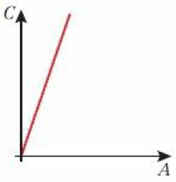
19.2 – More Direct Proportion
Page 707
a. d = 500t b. d = 2500km c. t = 4.5 hours. d. i. The distance doubles. ii. The distance halves.
a. b. C = 50A c. £4250

Slide 10
19.2 – More Direct Proportion
Page 707
a. y ∝ x² b. y = kx² c. k = 4 d. y = 100
a. y = 3.6x3 b. y = 230.4 c. x = 5
a. y = 25$\sqrt{x}$ b. y = 75 c. x = 100
y = 54

Slide 11
19.2 – More Direct Proportion
Page 707
a. E = 5s² b. E = 20J c. s = 6.2m/s d. The kinetic energy, E, is multiplied by 4.
a. C = 0.05s3 b. C = £6.25
a. T = $\frac{R2}{450}$ b. T = 50 minutes
g ∝ h³

Slide 12
19.3 – Inverse Proportion
Page 707
a. A = $\frac{B}{4}$ b. A = 115
a. y ∝ x b. y ∝ $\frac{1}{x}$ c. y ∝ x²
a. y = $\frac{10}{x}$ b. y = 0.5 c. x = 2.5
a. P = $\frac{3000}{V}$ b. P = 2000 N/m² c. x = 2.5m³ d. When the pressure doubles, the volume halves.

Slide 13
19.3 – Inverse Proportion
Page 707
a. t = $\frac{600 000}{P}$ b. No, it takes 4 minutes. When p = 2500W, t = 240seconds.
a. A graph showing inverse proportion. b. k = 8
The product of x and y is always 8, the constant of proportionality.
C

Slide 14
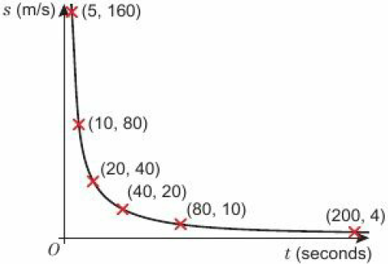
19.3 – Inverse Proportion
Page 707
a. t = $\frac{800}{s}$ b. c.
Speed, s, (m/s) | 4 | 10 | 20 | 40 | 80 | 160
Time, t, (secs) | 200 | 80 | 40 | 20 | 10 | 5

Slide 15
19.3 – Inverse Proportion
Page 707
a. a = 4, b = 2
a, b
Answers close to t = $\frac{300}{n}$
Answer using students’ formula from part c t = $\frac{33}{n}$ gives t = 20 minutes.

Slide 16
19.3 – Inverse Proportion
Page 707
1.33 (2 d.p.)
a. y = $\frac{54}{x3}$ b. y = 0.432 c. x = 2
a. y = $\frac{6}{\sqrt{x}}$ b. y = 3 c. x = 1
a. D = $\frac{6390}{r2}$ b. D = 10.2cm (1 d.p.) c. r = 10.0cm (1 d.p.)
a. s = $\frac{3400}{r2}$ b. s = 192.74

Slide 17
19.4 – Exponential Functions
Page 707
a. 16 b. 1 c. $\frac{1}{5}$ d. $\frac{1}{16}$
a. 512 b. 16,384 c. 524,288
a. x = 3 b. x = 4 c. x = 4

Slide 18
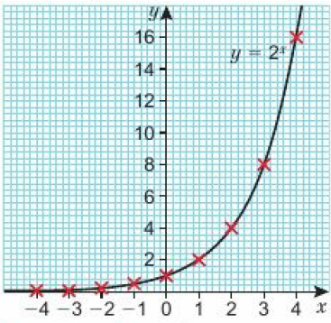
19.4 – Exponential Functions
Page 707
a. b. c. i. y ≈ 11 ii. x ≈ 3.3
x | -4 | -3 | -2 | -1 | 0 | 1 | 2 | 3 | 4
y | 0.06 | 0.13 | 0.25 | 0.5 | 1 | 2 | 4 | 8 | 16

Slide 19
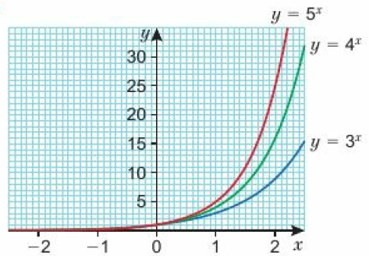
19.4 – Exponential Functions
Page 708
a, b. c. (0, 1)

Slide 20
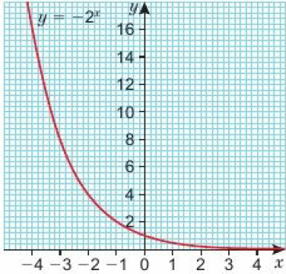
19.4 – Exponential Functions
Page 708
a. b. c. i. y ≈ 0.1 ii. x ≈ -3.3
x | -4 | -3 | -2 | -1 | 0 | 1 | 2 | 3 | 4
y | 16 | 8 | 4 | 2 | 1 | 0.5 | 0.25 | 0.13 | 0.06

Slide 21
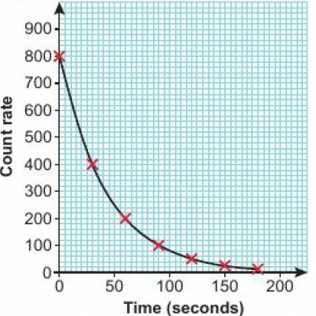
19.4 – Exponential Functions
Page 708
a. b. Exponential decay c. 30 seconds

Slide 22
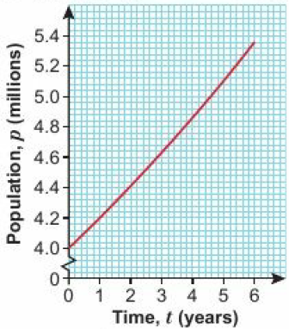
19.4 – Exponential Functions
Page 708
a = 5, k = $\frac{7}{5}$
a. a = 20,000, b = 0.9 b. £14580 c. 10%
a. b. i. p ≈ 4.5 million ii. t ≈ 4.6 years

Slide 23
19.4 – Exponential Functions
Page 708
a. V = 10,000 x 1.04^{t} b. c. t ≈ 2.4 years

Slide 24
19.5 – Non-Linear Graphs
Page 708
i = A, ii = D, iii = C, iv = D
180 m
a. 3 b. 1.5 c. -1
a. As time increases, the height increases at a faster rate, b. B

Slide 25
19.5 – Non-Linear Graphs
Page 708
a. T = 60°C
The rate of temperature change decreases over time.
10°C d. ≈ 0.1°C/sec
No, the average rate of temperature reduction ≈ 0.2°C/sec between 0 and 400 seconds,
The average rate of temperature reduction over the first 300 seconds ≈ 0.25°C. This is faster than the rate of temperature reduction at exactly 300 seconds ≈ 0.08°C/sec

Slide 26
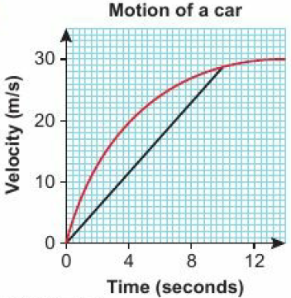
19.5 – Non-Linear Graphs
Page 708
a. 10m/s⁻¹ b. 10 seconds c. 24 seconds
a. b. 2.8 - 2.9m/s⁻² c. 2.5 - 3.0 m/s⁻² d. The rate of acceleration decreases over time, e. ≈ 94m

Slide 27
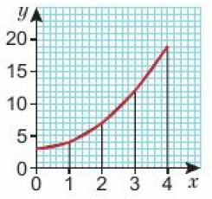
19.5 – Non-Linear Graphs
Page 708
a, b, c e. 34

Slide 28
19.5 – Non-Linear Graphs
Page 708
a. Amy is leading the race throughout. The distance between Amy and Clare increases for the first 45 seconds, then Clare accelerates and begins to close the gap.
Her average speed in the second half if the race is more than double her average speed in the first half.
Estimating from the graph: Amy – 7.25m/s; Claire 7.5m/s. Difference 0.25m/s
a. 2.5m/s b. 50m c. T = 3 sec

Slide 29
19.6 – Translating Graphs of Functions
Page 708
a. 7 b. -8 c. 2 d. 1 e. 0
a. i. 19 ii. 27 b. i. y = 5x + 4 ii. y = 5(x + 2) + 2
a. A b. B

Slide 30
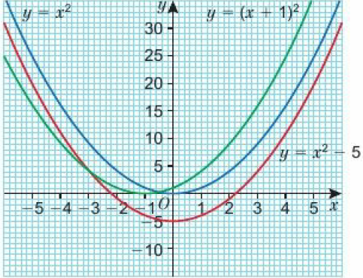
19.6 – Translating Graphs of Functions
Page 708
b. i. (0, -5) ii. (-1, 0) c. i. Translation by (${0 \atop −5}$) ii. Translation by (${−1 \atop 0}$) d. i. y = x² – 5 ii. y = (x + 1)²

Slide 31
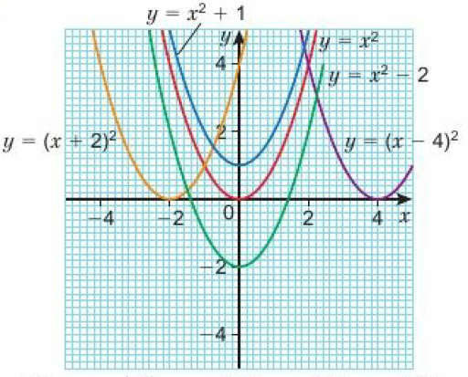
19.6 – Translating Graphs of Functions
Page 708
a. (${0 \atop 2}$) b. (${0 \atop −3}$) c. (${−1 \atop 0}$) d. (${4 \atop 0}$) e. (${−5 \atop −2}$)

Slide 32
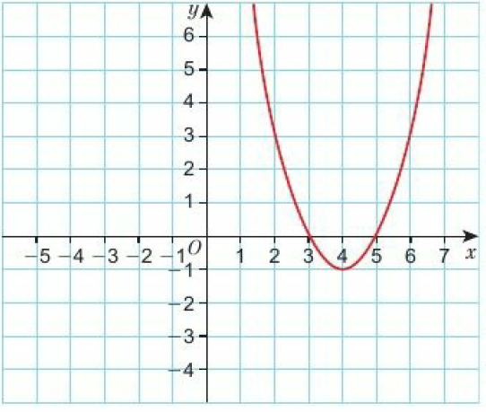
19.6 – Translating Graphs of Functions
Page 708
y = f(x - 6)

Slide 33
19.6 – Translating Graphs of Functions
Page 709
a. b. i. (0, 2) ii. (3, 0)

Slide 34
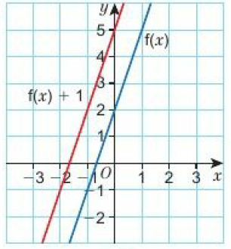
19.6 – Translating Graphs of Functions
Page 709
a, b. c. y = 3x + 5

Slide 35
19.6 – Translating Graphs of Functions
Page 709
a. b. x = -2 and y = -3

Slide 36
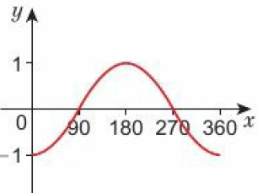
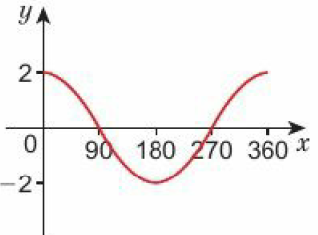
19.7 – Reflecting & Stretching Graphs of Functions
Page 709
a. -6x – 4 b. -6x + 4
a. 1 b. 50
a. b.

Slide 37
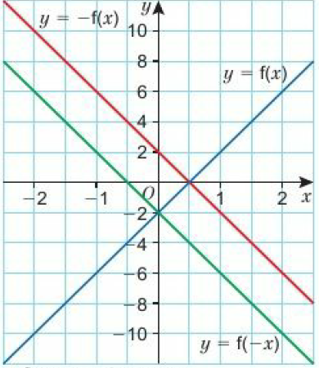
19.7 – Reflecting & Stretching Graphs of Functions
Page 710
a. b. c. Reflection in the x-axis d. Reflection in the y-axis
x | -2 | -1 | 0 | 1 | 2
f(x) | -10 | -6 | -2 | -2 | 6
-f(x) | 10 | 6 | 2 | -2 | -6
f(-x) | 6 | 2 | -2 | -6 | -10

Slide 38
19.7 – Reflecting & Stretching Graphs of Functions
Page 710
a. (2, -4) b. (-2, 4) c. (-2, -4)
a. b. Rotation of 180⁰ around (0, 0)

Slide 39
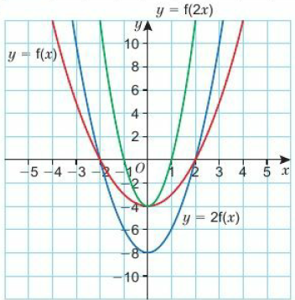
19.7 – Reflecting & Stretching Graphs of Functions
Page 710
a. b.
X | -4 | -3 | -2 | -1 | 0 | 1 | 2 | 3 | 4
f(x) | 12 | 5 | 0 | -3 | -4 | -3 | 0 | 5 | 12
2f(x) | 24 | 10 | 0 | -6 | -8 | -6 | 0 | 10 | 24
f(2x) | 60 | 32 | 12 | 0 | -4 | 0 | 12 | 32 | 60

Slide 40
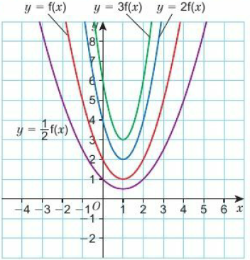
19.7 – Reflecting & Stretching Graphs of Functions
Page 710

Slide 41
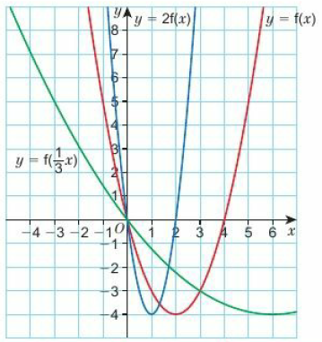
19.7 – Reflecting & Stretching Graphs of Functions
Page 711

Slide 42
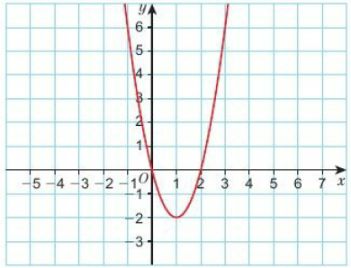
19.7 – Reflecting & Stretching Graphs of Functions
Page 711
a. D b. C c. B d. A

Slide 43
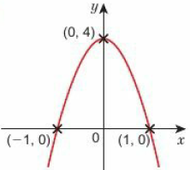
19.7 – Reflecting & Stretching Graphs of Functions
Page 711
a. b. (0, 4) c. (-1, 0) and (1, 0) d. The x² term is negative.

Slide 44
19 – Problem-Solving
Page 711
Total number of cases: 7, 14, 28, 56, 112. Day 4.
a. A = 3. b. B = 2.8.
It is more urgent to send more staff as they will be needed on day 6, whereas the extra supplies will not be needed until day 7.
Over time there will be fewer people who have not yet caught the disease. This model also does not include people who recover (or die) from the disease. Finally, the value of B might be influenced by human response to the illness (for example through the use of quarantine).

Slide 45
19 – Check-Up
Page 711
a. I = 2.5V b. I = 25 amps c. I = $\frac{40}{R}$ d. I = 10 amps
a. y = 12x2 b. y = 108 c. x = ±5
a. c = $\frac{352}{d3}$ b. c = 2.816

Slide 46
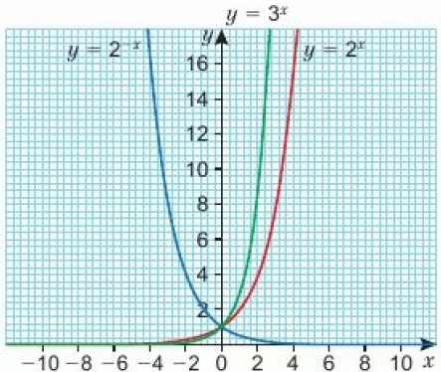
19 – Check-Up
Page 711
a. i. a = 3 ii. b = 2 b. 48
a. 0.9m/s b. 0.4m/s2 c. 530m

Slide 47
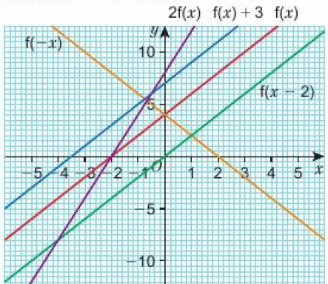
19 – Check-Up
Page 711

Slide 48
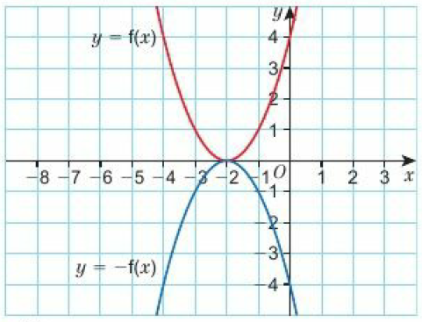
19 – Check-Up
Page 711
a. Yes b. Students’ own answers. c. Students’ own answers.

Slide 49
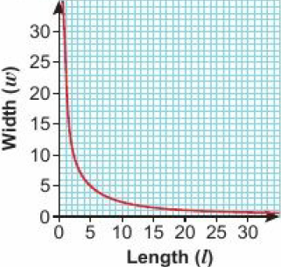
19 – Strengthen
Page 711
Proportion
a. c = 1.32l b. 9.09 litres (2 d.p.)
a. e.g. l = 24 w = 1, l = 12 w = 2, l = 8 w = 3, l = 6 w = 4 b. Indirectly proportional. c.

Slide 50
19 – Strengthen
Page 711
a. i b. ii
a. i. A ∝ B ii. A = kB b. i. C ∝ $\frac{1}{D}$ ii. C = $\frac{k}{D}$ c. i. M ∝ N² ii. C = kN² d. i. F ∝ $\frac{1}{G3}$ ii. C = $\frac{k}{G3}$ e. i. H ∝ $\frac{1}{\sqrt{T}}$ ii. C = $\frac{k}{\sqrt{T} }$ f. i. R ∝ S³ ii. C = kS³

Slide 51
19 – Strengthen
Page 711
a. k = 10 b. F = 10a c. F = 40 d. a = 6
a. k = 20 b. a = $\frac{20}{b}$ c. a = 4 d. b = 4
a. k = 5 b. d = 5t² c. d = 245 d. t = 3

Slide 52
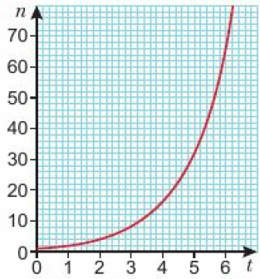
19 – Strengthen
Page 712
a. b, c.
t | 0 | 1 | 2 | 3 | 4 | 5 | 6
n | 1 | 2 | 4 | 8 | 16 | 32 | 64

Slide 53
19 – Strengthen
Page 712
a. 4 = ab° b. a = 4 c. 8 = 4b d. b = 2 e. y = 4 x 2^{x} f. y = 32
a. i. 20 m/s ii. 40m/s iii. 60m/s b. 0.4 m/s² c. i. 7.5 km ii. 2.5 km

Slide 54
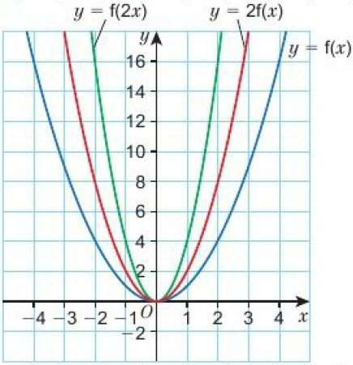
19 – Strengthen
Page 712
Transformations of Graphs of Functions
a. b, e, h.
x | -4 | -3 | -2 | -1 | 0 | 1 | 2 | 3 | 4
f(x) | 16 | 9 | 4 | 1 | 0 | 1 | 4 | 6 | 16

Slide 55
19 – Strengthen
Page 712
c. d. Double e. See above f. y = f(x) is stretched by a scale factor of 2 away from the x-axis. g. h. See above. i. y = f(x) is stretched by a scale factor of $\frac{1}{2}$ away from the x-axis.
x | -4 | -3 | -2 | -1 | 0 | 1 | 2 | 3 | 4
2f(x) | 32 | 16 | 8 | 2 | 0 | 2 | 8 | 16 | 32
x | -4 | -3 | -2 | -1 | 0 | 1 | 2 | 3 | 4
f(2x) | 64 | 32 | 16 | 4 | 0 | 4 | 16 | 32 | 64

Slide 56
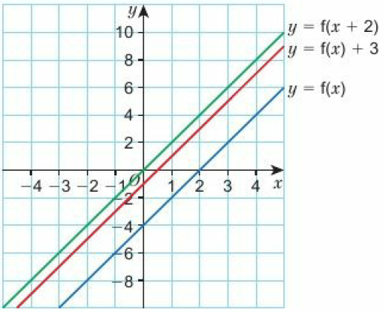
19 – Strengthen
Page 712
a. b, e, h
x | -3 | -2 | -1 | 0 | 1 | 2 | 3
f(x) | -10 | -8 | -6 | -4 | -2 | 0 | 2

Slide 57
19 – Strengthen
Page 712
c. d. 3 greater e. See above f. y = f(x) is translated by (${0 \atop 3}$). g. h. See above. i. y = f(x) is translated by (${−2 \atop 0}$).
x | -3 | -2 | -1 | 0 | 1 | 2 | 3
f(x) + 3 | -7 | -5 | -3 | -1 | 1 | 3 | 5
x | -3 | -2 | -1 | 0 | 1 | 2 | 3
f(x + 2) | -6 | -4 | -2 | 0 | 2 | 4 | 6

Slide 58
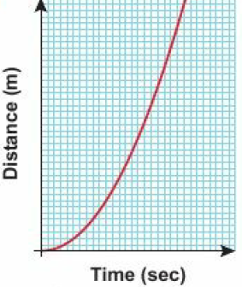
19 – Extend
Page 712
a. d = 5t² b. 45m c. 11 seconds d. e. It accelerates towards the ground

Slide 59
19 – Extend
Page 712
y = 2^{x} is D y = 6^{x} is C y = 0.5^{x} is A y = 3^{-x} is B
a. C b. D c. B d. E e. A
a. A = The ball is travelling upwards and decelerating B = The ball has reached its maximum height C = The ball is accelerating towards the ground
The speed at A is the same as the speed at C
The velocity at A and C have the same magnitude, but one is positive and one is negative.

Slide 60
19 – Extend
Page 713
a. £6556.36 b. A c. £2642.86
a. Month 1 and month 2. The graph is steepest gradient in this section.
The profits increased over the period. The increase was greatest between months 1 and 2, and then at a slower but fairly steady rate for the next 4 months.
£5 million

Slide 61
19 – Extend
Page 713
a. b. W ∝ r³ c. W = 0.004r³ d. 16.4 litres

Slide 62
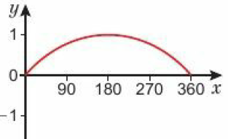
19 – Extend
Page 713
a. i. (0, 0) ii. (0, 0) iii. (0. 5) b. i. (1, 0), (3, 0), (5, 0) ii.(-8, 0), (0, 0), (8, 0)
a. b. 2

Slide 63
19 – Extend
Page 713
a. (-4, 0), (2, 0) b. (-1, -9) c.

Slide 64
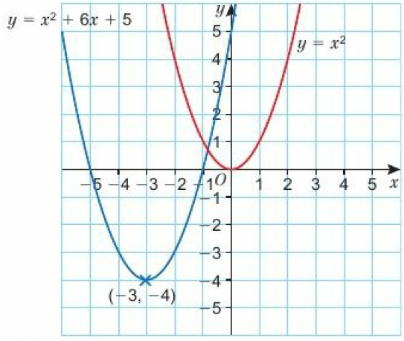
19 – Extend
Page 713
a. a = 3, b = 4 b, c.
a = 4, b = 2, c = 2
C₂ y = f(x + 2)

Slide 65
19 – Extend
Page 713
a.
x = -2 and y = -3
105 counts per second
a. £178,658.24 b. £15000

Slide 66
19 – Unit Test
Page 713
Sample student answer
Where the curve crosses the y-axis and the x-axis, and where the minimum/maximum points are.
The minimum point.
The student could label the axes with an approximate scale to help count the number of units to be moved.

